Slide 1
DATA SCIENCE & ML
BIG DATA · HADOOP
DATA ENGINEERING
Data Science, Big Data &
Data Engineering
Curriculum Topic Relationship & Architecture
Tata Elxsi · Learning & Development · Curriculum Architecture Reference · v1.0
"The three tracks are not independent — they are three perspectives on a single data platform."
Notes:
SPEAKER NOTES — COVER SLIDE
Welcome to the Curriculum Architecture Reference for Tata Elxsi's Data platform training programmes. This presentation covers three interconnected training tracks — Data Science & Machine Learning, Big Data (Hadoop Ecosystem), and Data Engineering (Pipelines & ETL).
Key message to open with: These three tracks are not three separate subjects. They are three perspectives on the same data platform. A Data Scientist needs pipelines to get clean data. A Data Engineer needs to understand ML requirements to design the right feature pipeline. A Big Data engineer provides the infrastructure that makes both possible. Together they complete the picture.
Presentation runs approximately 60–75 minutes with Q&A.

Slide 2
Agenda
Big Picture Architecture
Data Science Track
01
02
Three-pillar curriculum overview
Sequential learning flow & topic dependencies
Big Data — Hadoop Ecosystem
Data Engineering Track
03
04
Component architecture & data flow
Pipeline architecture & tool tracks
Cross-Domain Correlations
Topic Relationship Matrix
05
06
How the three tracks intersect
Dependency mapping across all modules
Learning Paths & Capstone
Key Insights & Gaps
07
08
Recommended sequences for four learner profiles
Curriculum strengths, blind spots & recommendations
Notes:
SPEAKER NOTES — AGENDA
This deck covers eight sections. We'll move through each one sequentially, spending the most time on the first five sections which contain the architecture diagrams.
Sections 1–5 are conceptual and architectural — they answer 'how do these topics relate?'
Sections 6–8 are practical — they answer 'in what order should we learn these?' and 'what's missing?'
Feel free to ask questions throughout. We'll have a dedicated Q&A at the end.

Slide 3
SECTION 1
Big Picture Architecture
Three-pillar curriculum overview with cross-domain links
Notes:
SECTION 1 DIVIDER
We begin with the big picture — how the three curriculum tracks relate at the highest level. This sets the mental model for everything that follows.

Slide 4
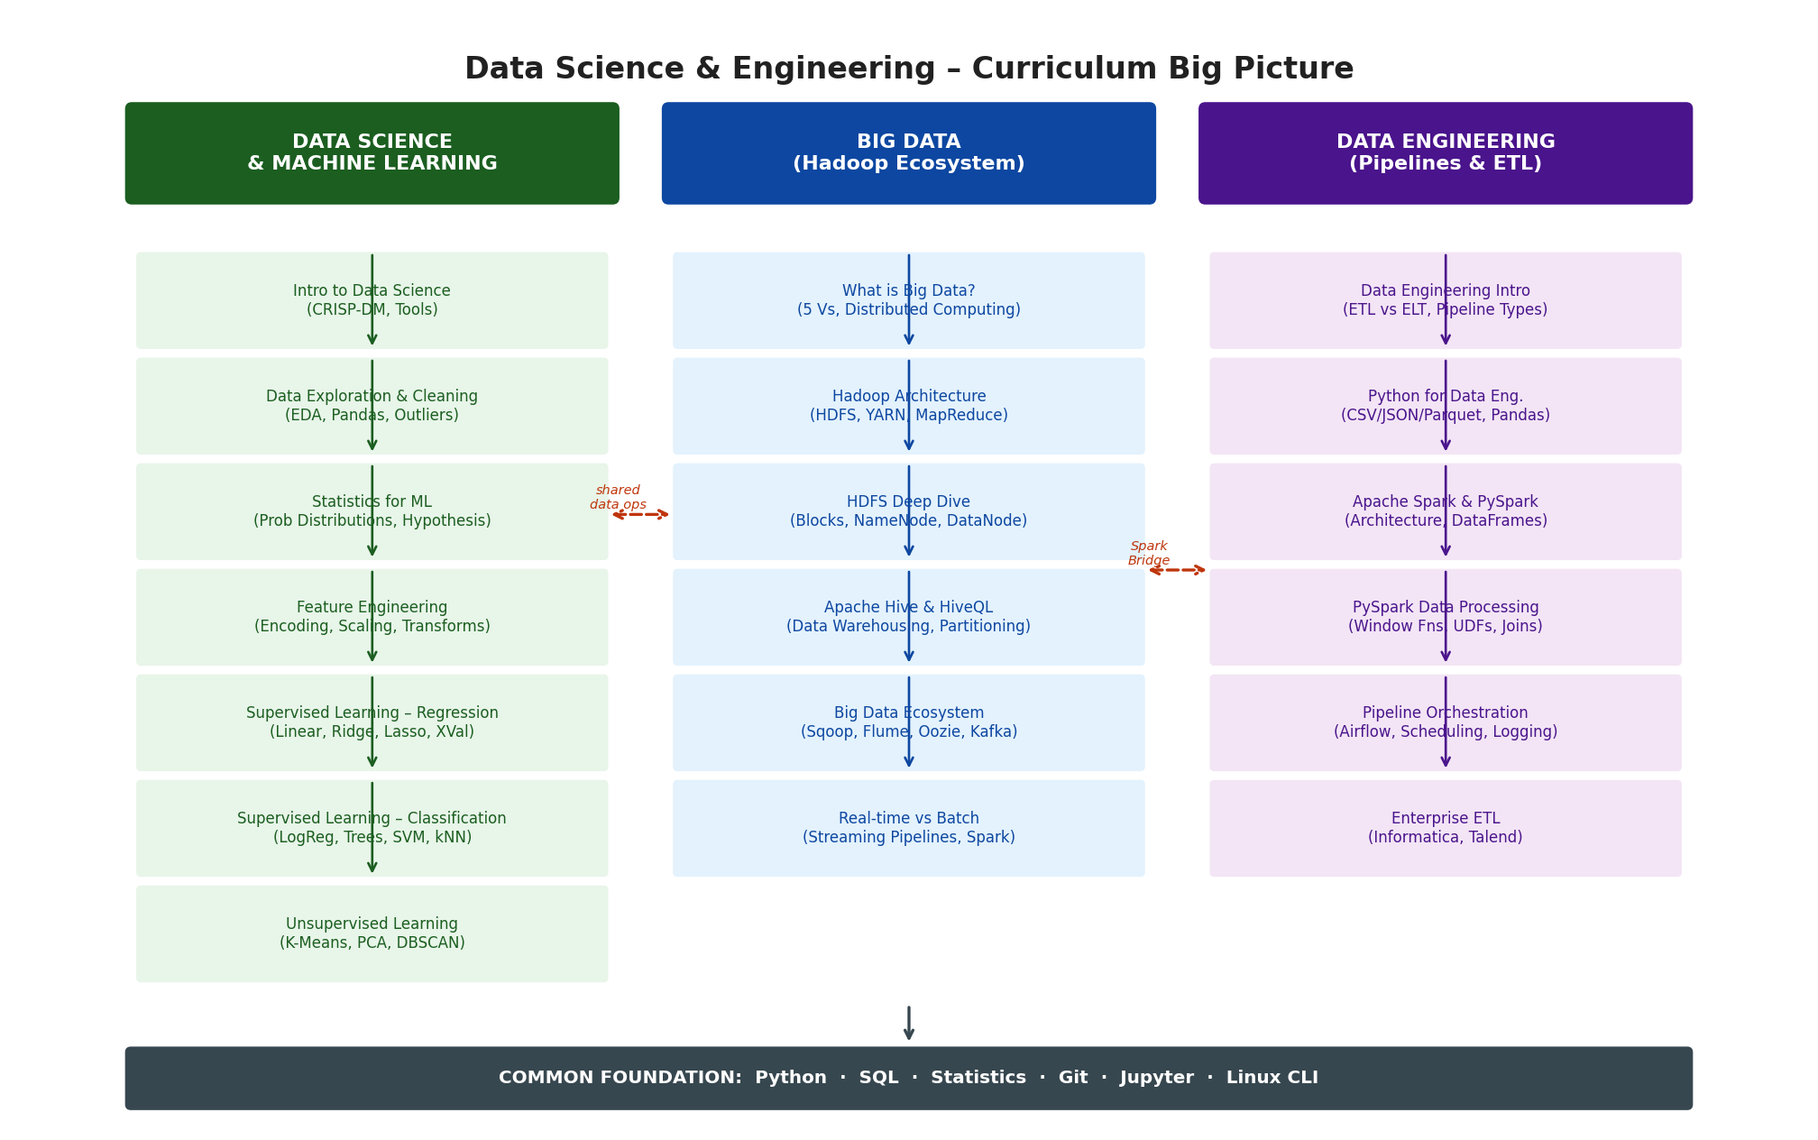
Section 1 — Big Picture: Three-Pillar Curriculum Architecture
Notes:
SPEAKER NOTES — BIG PICTURE DIAGRAM
This is the master architecture diagram. Three vertical pillars sit on a shared horizontal foundation.
PILLAR 1 — Data Science & ML (Green): Starts from raw data understanding and moves to model deployment. Every module is a prerequisite for the one below it. This is the analytical intelligence layer.
PILLAR 2 — Big Data / Hadoop (Blue): The infrastructure layer. When data exceeds single-machine capacity, this is where it lives. HDFS stores it, YARN manages compute, Hive and Spark query it.
PILLAR 3 — Data Engineering (Purple): The plumbing layer. Python and PySpark pipelines move and transform data; Airflow orchestrates complex workflows; Informatica and Talend handle enterprise-grade ETL.
FOUNDATION (Dark bar at bottom): Python, SQL, Statistics, Git, Jupyter, Linux CLI. These are non-negotiable Day-0 prerequisites for all three tracks.
CROSS-TRACK ARROWS (Orange dashed): Show where the tracks share concepts — most importantly where PySpark bridges Data Engineering and Big Data, and where Feature Engineering from DS feeds into DE pipelines.

Slide 5
Section 1 — The Three Pillars: Roles & Responsibilities
📊 Data Science & ML
🗄️ Big Data / Hadoop
⚙️ Data Engineering
Analytical Intelligence Layer
Infrastructure & Distributed Storage
Pipeline & Transformation Layer
Transforms raw data into insight & predictions
Owns the model: from EDA to deployment
Outputs: trained models, business recommendations
Key tools: Scikit-learn, Pandas, Jupyter, Python
Handles TB-to-PB scale data volumes
Provides distributed file system (HDFS) & compute (YARN)
Makes raw data accessible for DS and DE teams
Key tools: Hadoop, Hive, Spark, Sqoop, Kafka
Moves data from source systems to consumers
Owns ETL/ELT: extract, clean, transform, load
Enables ML-ready datasets & BI feeds
Key tools: Python, PySpark, Airflow, Informatica, Talend
SHARED FOUNDATION · Python · SQL · Statistics · Git · Jupyter · Linux CLI
Notes:
SPEAKER NOTES — THREE PILLARS DETAIL
This slide expands the three pillars into their specific roles and responsibilities.
DATA SCIENCE (Green): The intelligence layer. Data Scientists consume data produced by the other two tracks and turn it into predictive models, statistical insights, and business recommendations. They typically don't build the infrastructure — they depend on it.
BIG DATA (Blue): The infrastructure layer. This pillar explains WHY we need distributed computing — when data volumes exceed single-machine RAM and disk, you need HDFS, YARN, and MapReduce/Spark. Without this layer, Data Scientists would have no way to access petabyte-scale training data.
DATA ENGINEERING (Purple): The connective tissue. Data Engineers build the pipelines that move data from operational databases into the storage layers and feature stores that Data Scientists consume. They are the bridge between raw data and analytical value.
FOUNDATION (Dark bar): Emphasise this strongly. Python, SQL, Statistics, Git and Jupyter are not optional — they are baseline competencies every learner must have BEFORE entering any of the three tracks. These should be assessed as entry criteria, not taught within the tracks.

Slide 6
SECTION 2
Data Science & Machine Learning Track
8-module sequential dependency chain from EDA to Model Evaluation
Notes:
SECTION 2 DIVIDER
Now we drill into the Data Science track in detail. The key theme here is sequential dependency — each module is a prerequisite for the next. You cannot skip steps.

Slide 7
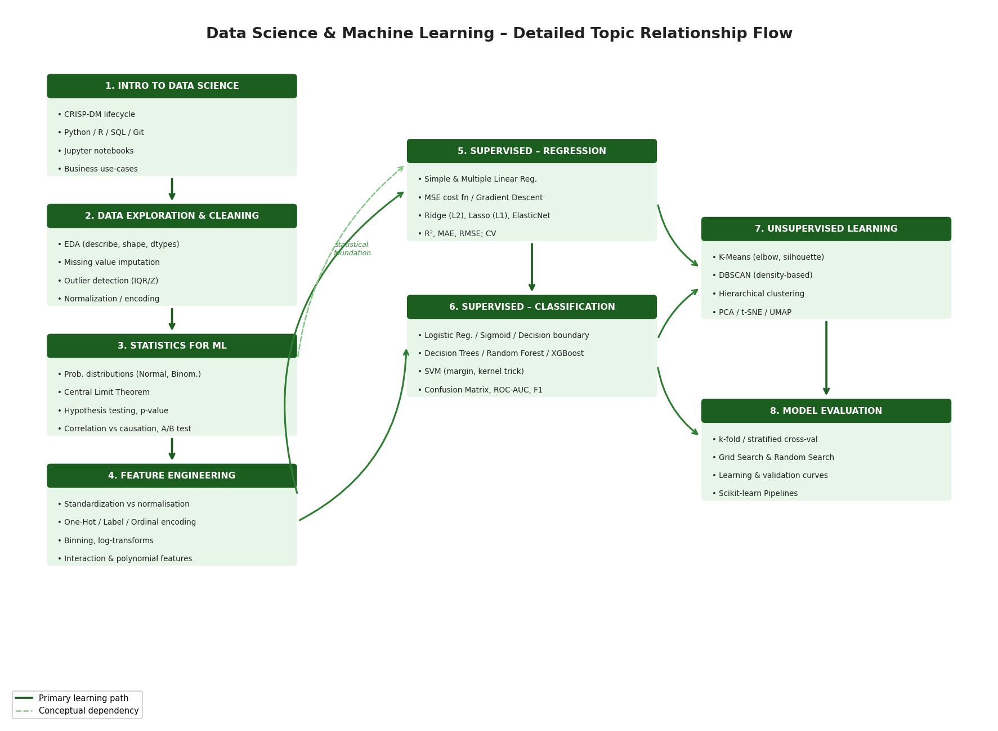
Section 2 — Data Science Learning Flow: Module Dependency Map
Notes:
SPEAKER NOTES — DS FLOW DIAGRAM
This directed graph shows how each of the 8 Data Science modules depends on previous modules.
SOLID GREEN ARROWS = Primary learning path (must complete in this order)
DASHED GREEN ARROWS = Conceptual dependency (helpful foundation, less strict prerequisite)
Key dependency chains to call out:
1. Modules 1→2→3→4 form the LEFT COLUMN (data preparation pipeline). These are strictly sequential. You cannot do Feature Engineering (4) without EDA (2) and Statistics (3).
2. Module 4 (Feature Engineering) is the BRIDGE — both Regression (5) and Classification (6) depend on it. This is the single most critical module in the track.
3. Modules 5 and 6 (Regression & Classification) run PARALLEL — they share evaluation concepts and the same ML workflow. Regression naturally comes first because Logistic Regression is built on Linear Regression.
4. Module 7 (Unsupervised) branches from both supervised modules — PCA feeds back into supervised preprocessing, clustering provides alternative when labels aren't available.
5. Module 8 (Model Evaluation) is the CAPSTONE — it applies to ALL previous modules. Cross-validation, pipelines, and grid search wrap the entire learning journey.

Slide 8
Section 2 — Data Science: Key Module Dependency Analysis
Module Transition | Relationship Type | Why It Matters
EDA (M2) → Statistics (M3) | BIDIRECTIONAL | EDA surfaces distributions and outliers; Statistics explains why they matter. Each reinforces the other in a tightly coupled feedback loop.
Statistics (M3) → Feature Eng. (M4) | PREREQ | Choosing log/Box-Cox transforms requires knowing why skewed distributions break linear models — a Statistics concept applied in Feature Engineering.
Feature Eng. (M4) → Regression (M5) | HARD PREREQ | Feature Engineering prepares the input matrix. Without scaling and encoding, linear models receive garbage input and produce meaningless output.
Regression (M5) → Classification (M6) | EXTENDS | Logistic Regression extends Linear Regression via the sigmoid function. Evaluation framework (confusion matrix, AUC) builds on regression's MAE/RMSE concepts.
Supervised (M5,6) → Unsupervised (M7) | MOTIVATES | After learning supervised methods, learners understand labelling costs — the key motivation for unsupervised approaches. PCA also pre-processes features for supervised models.
All Modules → Model Evaluation (M8) | SYNTHESIS | Cross-validation and Scikit-learn Pipelines apply universally. M8 wraps M4→M8 into a production-ready automated workflow.
Notes:
SPEAKER NOTES — DS MODULE DEPENDENCIES TABLE
This table captures the 'why' behind each module transition. Use these explanations when learners ask 'why do we have to study X before Y?'
KEY TALKING POINTS:
• HARD PREREQ between Feature Engineering and Regression is the most important: raw data fed directly into a Linear Regression will produce near-random results. Feature preparation is not optional.
• The BIDIRECTIONAL relationship between EDA and Statistics is pedagogically interesting — in practice, learners encounter skewness and outliers DURING EDA before formally studying statistics. Consider interleaving these modules rather than doing them sequentially.
• SYNTHESIS at the end (Model Evaluation) is often underestimated. Scikit-learn Pipelines wrap everything from feature encoding to cross-validated model selection in a single reusable object — this is the closest thing to 'production ML' the DS track covers.

Slide 9
SECTION 3
Big Data — Hadoop Ecosystem
Layered component architecture: ingestion to orchestration
Notes:
SECTION 3 DIVIDER
Moving to the Big Data track. The central concept here is layers — Hadoop is not one tool but a stack of specialised components, each serving a distinct function in the data flow.

Slide 10
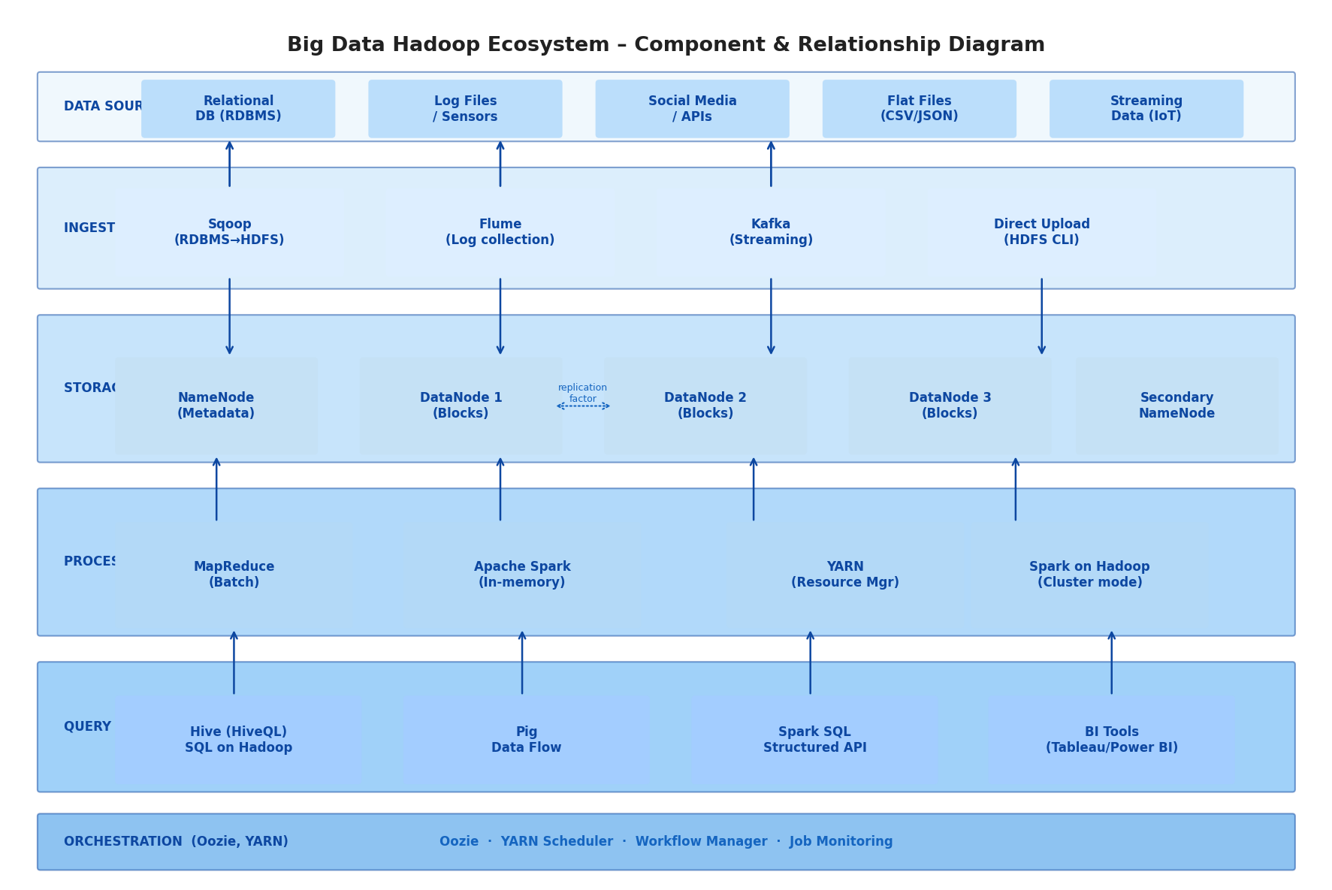
Section 3 — Hadoop Ecosystem: Component Architecture & Data Flow
Notes:
SPEAKER NOTES — BIG DATA ECOSYSTEM DIAGRAM
This layered architecture diagram shows exactly where data enters the Hadoop ecosystem and how it flows through each layer to produce analytical output.
DATA SOURCES (top layer): Enterprise data is messy and diverse — relational databases, log files, IoT sensors, flat files, and real-time streams. Big Data infrastructure handles ALL of these simultaneously.
INGESTION LAYER: Four tools, four use cases:
• Sqoop — batch import from RDBMS (Oracle, MySQL) into HDFS using parallel JDBC
• Flume — streaming collection of log event data from application servers
• Kafka — real-time publish-subscribe for IoT and event-driven architectures
• Direct CLI — simple file-based ingestion using hadoop fs -put commands
HDFS STORAGE: The NameNode holds metadata only (block locations, file permissions). DataNodes hold actual 128MB block replicas. Default replication factor = 3 means every block exists on 3 different DataNodes — hence the 'fault tolerant' claim. Secondary NameNode is NOT a failover — it merges edit logs periodically.
PROCESSING: MapReduce = write to disk between phases (slow but reliable). Spark = in-memory (10-100x faster for iterative ML workloads). YARN allocates CPU/RAM to every job regardless of whether it's MapReduce or Spark.
QUERY/ANALYTICS: Hive translates SQL to MapReduce/Tez — makes Hadoop accessible to analysts. Spark SQL does the same but faster. Results feed BI tools.
ORCHESTRATION: Oozie schedules multi-step workflows (e.g., daily: Sqoop import → Hive transform → result export).

Slide 11
Section 3 — Big Data: Week-by-Week Topic Dependencies
WEEK 1
WEEK 2
WEEK 3
Hadoop Fundamentals
Hive & Data Warehousing
Advanced Ecosystem & Spark
5 Vs of Big Data — Volume, Velocity, Variety, Veracity, Value
Hadoop Architecture — NameNode, DataNode, YARN
HDFS Deep Dive — blocks, replication, fault tolerance
MapReduce — Map phase, shuffle, Reduce phase
Hands-on: HDFS CLI commands, file transfer, cluster monitoring
Apache Hive architecture & Metastore
HiveQL — CREATE, SELECT, JOIN, GROUP BY
Partitioning & Bucketing — critical for query performance
Data loading and transformation workflows
Hands-on: SQL queries on large HDFS datasets
Sqoop — import RDBMS data into HDFS
Flume — log collection pipelines
Oozie — workflow scheduling and monitoring
Kafka — streaming basics & pub-sub model
Apache Spark on Hadoop — in-memory processing, Spark SQL
→ Week 2 needs HDFS as storage layer for Hive tables
→ Week 3 uses Hive concepts for ecosystem integration
→ Spark bridges into Data Engineering track (PySpark)
Notes:
SPEAKER NOTES — BIG DATA WEEKLY DEPENDENCIES
The Big Data curriculum is structured across three weeks. Each week feeds directly into the next.
WEEK 1 → WEEK 2 DEPENDENCY: Hive tables are directories on HDFS. You cannot understand Hive partitioning without understanding HDFS directory structure. Week 1 is an absolute prerequisite for Week 2.
WEEK 2 → WEEK 3 DEPENDENCY: Sqoop (Week 3) imports RDBMS data INTO HDFS where Hive then runs queries on it. Oozie (Week 3) orchestrates Hive jobs defined in Week 2. The ecosystem tools only make sense when the underlying infrastructure (HDFS, Hive) is understood.
WEEK 3 → DATA ENGINEERING TRACK: This is the most important cross-track dependency. Spark introduced in Week 3 is the foundation for PySpark in the Data Engineering track. Kafka introduced here feeds PySpark Structured Streaming in DE. Learners who complete Big Data Week 3 are prepared to enter the PySpark modules of Data Engineering without a conceptual gap.
IMPORTANT MISCONCEPTION TO ADDRESS: MapReduce vs. Spark — many learners ask 'why learn MapReduce if Spark replaced it?' Answer: MapReduce concepts (partition, shuffle, reduce) directly explain Spark's behaviour. Debugging slow Spark jobs often requires understanding shuffle operations — which are MapReduce concepts.

Slide 12
SECTION 4
Data Engineering Track
Three tool tracks converging at a unified data store
Notes:
SECTION 4 DIVIDER
Data Engineering is the most practically complex track because it covers three different tool families at different scales — Python scripts, PySpark distributed processing, and enterprise ETL platforms.

Slide 13
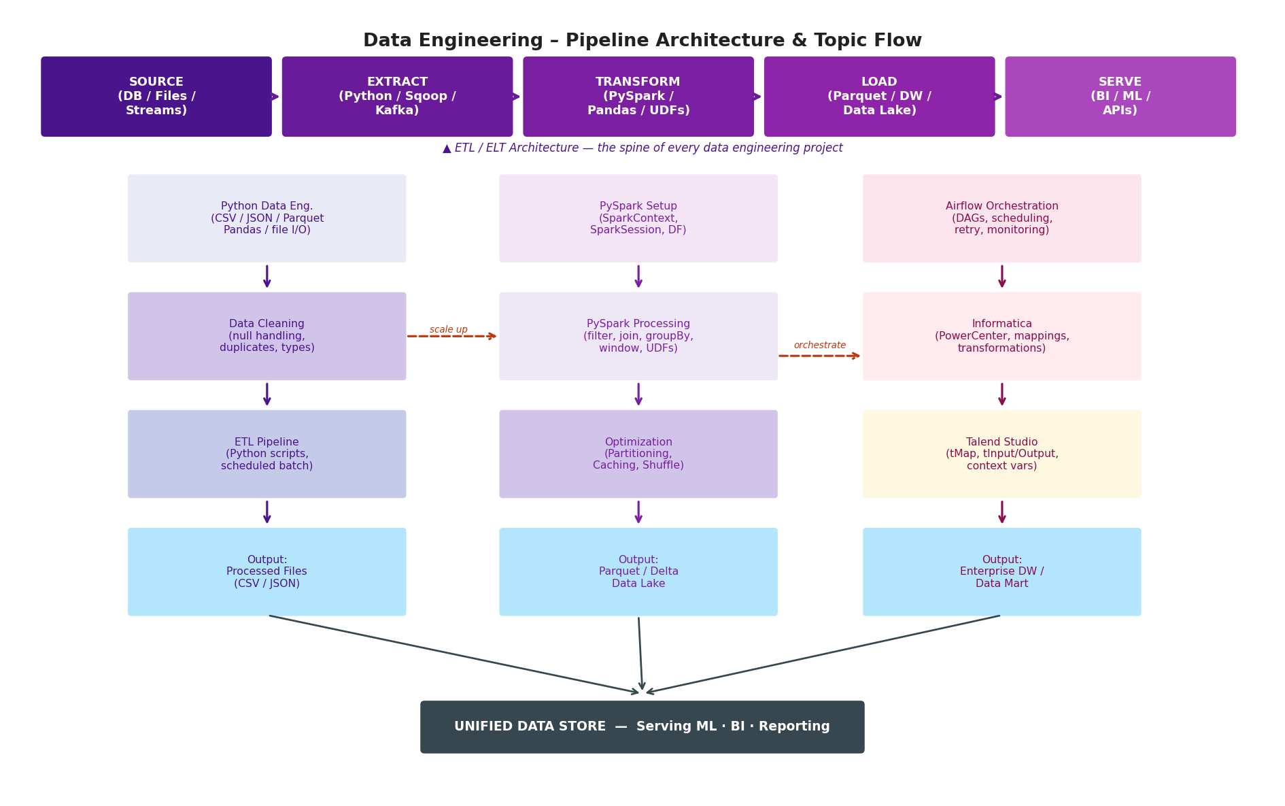
Section 4 — Data Engineering Pipeline Architecture & Tool Flow
Notes:
SPEAKER NOTES — DATA ENGINEERING PIPELINE DIAGRAM
This diagram has two major parts:
1. THE ETL SPINE (top banner): Source → Extract → Transform → Load → Serve. This five-stage pipeline is universal — every data engineering project, regardless of tools, follows this pattern. The tools change; the architecture does not.
2. THREE TOOL TRACKS (below): The curriculum teaches this architecture at three levels:
• TRACK A (Python): Entry-level. Pandas + Python scripts. Works for datasets up to ~10GB. Simple, fast to develop, easy to debug.
• TRACK B (PySpark): Scale-up path. Same concepts as Track A but distributed across a cluster. Can handle hundreds of GB to TB.
• TRACK C (Enterprise ETL): Production grade. Informatica and Talend add governance, lineage, audit logs, and GUI-based pipeline design — critical for regulated industries.
CROSS-TRACK ARROWS:
• Python → PySpark (scale up): When a Python ETL job becomes too slow, you 'scale up' by rewriting it in PySpark. The data transformations are identical; the execution engine changes.
• PySpark → Airflow (orchestrate): Airflow DAGs trigger PySpark jobs using SparkSubmitOperator. The pipeline logic lives in PySpark; the scheduling and monitoring lives in Airflow.
CONVERGENCE AT BOTTOM: All three tracks feed the same unified data store — this might be a Parquet Data Lake on HDFS, a Snowflake Data Warehouse, or a cloud storage bucket. Downstream consumers (ML models, BI tools, APIs) don't care which track produced the data.

Slide 14
Section 4 — Three Tool Tracks: When to Use What
🐍 Track A — Python Pipelines
⚡ Track B — PySpark
🏢 Track C — Enterprise ETL
Scale: Up to ~10 GB
Scale: GB to TB scale
Scale: Enterprise / regulated
When: Prototyping, small-scale ETL, one-off data tasks
When: Production pipelines on Hadoop/cloud clusters
When: Mission-critical production ETL with governance requirements
✓ Strengths
✓ Strengths
✓ Strengths
Fastest to develop and debug
Rich ecosystem (Pandas, NumPy, SQLAlchemy)
Works without cluster infrastructure
Easy to integrate with REST APIs
Distributed across 100s of nodes
Lazy evaluation — optimised execution plan
Unified API for batch and streaming
Native Hadoop/HDFS integration
GUI-based pipeline design — no-code/low-code
Built-in data lineage and audit logging
Enterprise support and SLA guarantees
Handles incremental and full loads natively
⚠ Limitations
⚠ Limitations
⚠ Limitations
Single machine — memory bound
Not suitable for TB-scale data
No native scheduling or monitoring
Higher learning curve
Cluster setup and management overhead
Debugging distributed failures is hard
Expensive licensing (Informatica)
Less flexible than code-based pipelines
Vendor lock-in risk
Notes:
SPEAKER NOTES — THREE TOOL TRACKS
This slide answers the practical question: 'which tool should I use for which job?'
TRACK A (Python): This is where everyone starts. Python pipelines are fast to write, easy to debug, and don't require any infrastructure. The limitation is memory — once your dataset doesn't fit in RAM, Python crashes. This is the signal to move to Track B.
TRACK B (PySpark): PySpark is Python's distributed counterpart. The DataFrame API is almost identical to Pandas — learners who know Pandas will find PySpark familiar. The key difference is execution model: Spark uses lazy evaluation, which means transformations don't execute until you call an action (count(), show(), write()). This allows Spark to optimise the entire execution plan before running a single line.
TRACK C (Informatica/Talend): Enterprise tools exist because regulated industries (banking, healthcare, insurance) need provable data lineage — you must be able to answer 'where did this number come from?' for every record in a report. Python scripts can't provide that out of the box. Informatica and Talend build it in.
PRACTICAL GUIDANCE: Most learners will use Track A and B in their daily work. Track C is for those who join implementation teams working on SAP/Oracle data migrations or enterprise analytics platforms. Don't dismiss it — Informatica skills are highly valued and well-paid in the market.

Slide 15
SECTION 5
Cross-Domain Correlation Map
How Data Science, Big Data & Data Engineering intersect
Notes:
SECTION 5 DIVIDER
This is arguably the most important section — it shows where the three tracks share concepts, which helps learners understand that skills transfer across domains, and that the tracks are complementary, not competing.

Slide 16
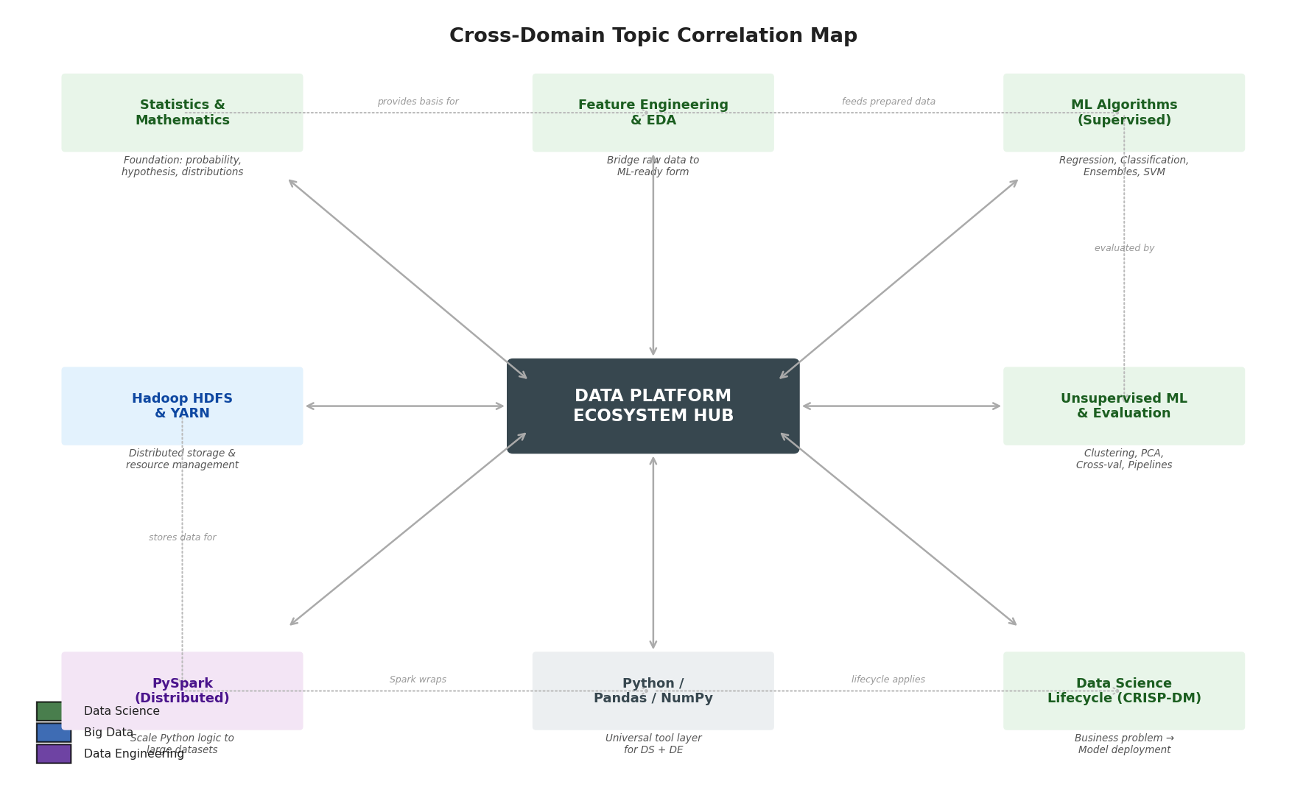
Section 5 — Cross-Domain Correlation Map
Notes:
SPEAKER NOTES — CROSS-DOMAIN CORRELATION DIAGRAM
This hub-and-spoke diagram places the 'Data Platform Ecosystem Hub' at the centre and shows eight key concept nodes from all three tracks orbiting it.
READ THE DIAGRAM:
• Every node connects bidirectionally to the central hub — all topics contribute to and consume from the shared data platform.
• The outer ring connections (dotted lines) show CROSS-DOMAIN relationships — e.g., Statistics provides the mathematical basis for Feature Engineering, which feeds ML algorithms.
TOP ROW (left to right): Statistics → Feature Engineering → Supervised ML
• Statistics provides the mathematical foundation for choosing transformations in Feature Engineering
• Feature Engineering prepares data that Supervised ML algorithms consume
BOTTOM ROW (left to right): HDFS → Python/Pandas → CRISP-DM Lifecycle
• HDFS stores the data that Python pipelines process
• Python/Pandas is the universal tool layer — used in both DS (Pandas for EDA) and DE (Pandas for ETL scripts)
• CRISP-DM is the lifecycle that governs every DS project regardless of which tools are used
RIGHT COLUMN: Unsupervised ML ↔ PySpark
• PySpark MLlib implements the same clustering (K-Means, DBSCAN) and dimensionality reduction (PCA) algorithms as Scikit-learn — but at distributed scale
BOTTOM LEFT: HDFS ↔ PySpark
• The tightest technical coupling in the entire map — PySpark reads from and writes to HDFS; HDFS block size determines PySpark partition count

Slide 17
Section 5 — Five Critical Cross-Domain Relationships
📊↔⚡
Statistics (DS) ↔ PySpark Processing (DE)
Aggregation operations (mean, stddev, percentile) in Statistics are identical to PySpark df.agg() and window functions. Data quality checks in DE are applied statistics.
🗄️↔⚡
HDFS (BD) ↔ PySpark (DE)
PySpark runs on YARN, reads/writes HDFS. HDFS block size (128MB) = default Spark partition size. Data locality in HDFS determines Spark job speed.
🔧↔⚙️
Feature Engineering (DS) ↔ Data Pipelines (DE)
Feature engineering operations must be operationalised inside production DE pipelines. Scikit-learn Pipeline ≈ Airflow DAG at different abstraction levels.
🗃️↔🔧
Hive (BD) ↔ Feature Engineering (DS)
Hive SQL materialises feature tables at scale. 'Average order value per customer last 30 days' is a Hive query that produces an ML feature. This is the Feature Store pattern.
📅↔🤖
Airflow (DE) ↔ Model Training (DS)
Airflow orchestrates ML training pipelines end-to-end: ingest → feature eng → train → evaluate → register. This is the MLOps pipeline where DS and DE converge.
Notes:
SPEAKER NOTES — CRITICAL CROSS-DOMAIN RELATIONSHIPS
These five relationships are the most important connections in the entire curriculum. If learners understand these, they understand why the three tracks exist as a system.
RELATIONSHIP 1 — Statistics ↔ PySpark: The operations are identical — only the syntax and scale differ. A learner who can compute a weighted average in Pandas can immediately understand df.agg({'value': 'mean'}) in PySpark. This is why Statistics in the DS track is relevant to DE practitioners.
RELATIONSHIP 2 — HDFS ↔ PySpark: This is a hard technical dependency. A PySpark job that reads 1TB from HDFS will create 8,192 partitions (at 128MB block size). Understanding this partition count helps engineers tune memory and parallelism settings. Without HDFS knowledge, PySpark performance tuning is guesswork.
RELATIONSHIP 3 — Feature Engineering ↔ Pipelines: This is the MLOps gap in the curriculum. Feature transformations built in a Jupyter notebook must be converted to pipeline steps that run in production. Scikit-learn's Pipeline object is the bridge — it wraps transformers and estimators in a single object that can be serialised and served.
RELATIONSHIP 4 — Hive ↔ Feature Engineering: Feature Stores (Feast, Hopsworks, Tecton) are production implementations of this relationship. Hive queries aggregate historical features; these are cached and served to ML models at training time. This is where Big Data infrastructure directly enables ML at scale.
RELATIONSHIP 5 — Airflow ↔ Model Training: Modern ML platforms (Kubeflow, MLflow, SageMaker Pipelines) are essentially Airflow-like orchestrators specialised for ML workflows. Understanding Airflow DAGs gives learners the mental model for all of these platforms.

Slide 18
Section 5 — Cross-Domain Concept Equivalence
Data Science Concept | Data Engineering Equivalent | Shared Underlying Principle
Data Cleaning (EDA / DS) | PySpark Data Processing (DE) | Null handling, type casting, deduplication — same operation, different API
Scikit-learn Pipeline | Apache Airflow DAG | Directed workflow of sequential processing steps; both support branching and error handling
Train / Test Split | Incremental Load (DE) | Partitioning data for different processing purposes — time-based or ratio-based
Model Evaluation Metrics (MAE, F1) | Data Quality Checks (DE) | Measuring output correctness — statistical error vs. schema drift / null rate
PCA / Dimensionality Reduction | Parquet Columnar Format | Reducing data footprint while retaining the information needed for downstream processing
Feature Importance (RF/XGBoost) | Data Profiling (DE) | Identifying which fields carry signal and which are noise or redundant
Cross-Validation (k-fold) | A/B Testing (DS/Product) | Robust comparison of two approaches using statistically independent validation sets
Notes:
SPEAKER NOTES — CONCEPT EQUIVALENCE TABLE
This table reframes the curriculum in terms of shared underlying principles. This is extremely useful for learners who come from one track and are being introduced to another.
HOW TO USE THIS TABLE IN TRAINING:
For a Data Scientist learning Data Engineering: 'You already know cross-validation — it's conceptually the same as A/B testing. You already know Scikit-learn Pipelines — Airflow DAGs are the same idea at a different scale.'
For a Data Engineer learning Data Science: 'You already build data quality checks — model evaluation metrics are the same thing applied to ML model output. You already handle schema drift — that's essentially the same problem as model drift in production.'
KEY INSIGHT TO SHARE: The reason cross-functional data teams work well is not that everyone knows everything — it's that the underlying mental models transfer. A Data Engineer who understands why Data Scientists need feature consistency can design better pipelines. A Data Scientist who understands ETL constraints can design more pipeline-friendly feature transformations.

Slide 19
Section 6 — Topic Relationship Matrix (Cross-Domain Dependency Map)
Topic ↓ / Topic →
EDA & Stats
Feature Eng.
Supervised ML
Unsupervised
HDFS/Hadoop
PySpark/DE
EDA & Stats
—
PREREQ
PREREQ
PREREQ
FEEDS
FEEDS
Feature Eng.
EXTENDS
—
PREREQ
PREREQ
FEEDS
EQUIVALENT
Supervised ML
PARALLEL
PARALLEL
—
PARALLEL
FEEDS
FEEDS
Unsupervised
PARALLEL
PARALLEL
PARALLEL
—
FEEDS
FEEDS
HDFS/Hadoop
PROVIDES
PROVIDES
PROVIDES
PROVIDES
—
EXTENDS
PySpark/DE
EQUIVALENT
EQUIVALENT
FEEDS
FEEDS
PARALLEL
—
PREREQ
EXTENDS
PARALLEL
FEEDS
EQUIVALENT
PROVIDES
Notes:
SPEAKER NOTES — TOPIC RELATIONSHIP MATRIX
This matrix is a compact summary of all cross-topic dependencies across the curriculum. Read it as: 'The row topic has [relationship] to the column topic.'
HOW TO READ: Row = source topic, Column = target topic. The cell describes how the row topic relates to the column topic.
KEY OBSERVATIONS:
1. EDA & Stats has PREREQ relationship with Feature Engineering, Supervised ML, AND Unsupervised ML — it is the most foundational topic in the DS track.
2. HDFS/Hadoop PROVIDES to all DS and DE topics — it is pure infrastructure. Nothing else depends on it in a pedagogical sense, but practically everything runs on top of it.
3. PySpark/DE shows EQUIVALENT with EDA & Stats and Feature Engineering — reinforcing the cross-domain insight that these are the same concepts at different scales.
4. The diagonal cells (—) represent self-reference — a topic always relates to itself.
5. Notice there are no EQUIVALENT relationships within the DS track — DS topics are all PREREQ or PARALLEL, reflecting the strict sequential learning path.
USE THIS MATRIX in curriculum design to identify: Which topics have the most incoming dependencies? (= highest priority, teach early) Which topics have the most outgoing FEEDS relationships? (= most foundational, spend most time on).

Slide 20
SECTION 7
Learning Paths & Capstone
Recommended sequences for four learner profiles
Notes:
SECTION 7 DIVIDER
Now we turn to practical application — how should a learner navigate this curriculum? The answer depends on their target role.

Slide 21
Section 7 — Four Learner Profiles & Recommended Paths
📊 Data Scientist
Duration: ~12 weeks
⚙️ Data Engineer
Duration: ~10 weeks
Foundation (Python, SQL, Stats)
EDA + Data Cleaning (Pandas)
Statistics for ML (Distributions, Hypothesis)
Feature Engineering (Encoding, Scaling)
Supervised: Regression (Linear, Ridge, Lasso)
Supervised: Classification (Trees, XGBoost, SVM)
Unsupervised + Model Evaluation (PCA, CV)
+ Big Data awareness (HDFS, Hive basics)
Foundation (Python, SQL, Linux CLI)
Python Data Engineering (CSV/JSON/Parquet)
Big Data Fundamentals (HDFS, YARN basics)
PySpark Introduction (Architecture, DataFrames)
PySpark Processing (Joins, Window fns, UDFs)
Apache Airflow (DAGs, scheduling)
Enterprise ETL (Informatica or Talend)
Capstone: end-to-end pipeline
🗄️ Big Data Specialist
Duration: ~8 weeks
🌐 Full-Stack Data Pro
Duration: ~20 weeks
Foundation (Python, SQL, Linux CLI)
Big Data & Distributed Computing (5 Vs)
HDFS Deep Dive (Blocks, NameNode, Replication)
YARN & MapReduce (Resource mgmt, MR phases)
Apache Hive (HiveQL, Partitioning, Bucketing)
Ecosystem Tools (Sqoop, Flume, Oozie, Kafka)
Apache Spark on Hadoop (Cluster mode, Spark SQL)
PySpark Data Engineering (cross-track bridge)
Foundation → EDA + Statistics
Feature Engineering → Big Data Infrastructure
PySpark Data Engineering → Supervised ML
Unsupervised + Model Evaluation → Airflow
Enterprise ETL (Informatica/Talend)
Capstone: integrates ALL three tracks
Notes:
SPEAKER NOTES — FOUR LEARNING PATHS
These four paths represent the most common role trajectories for learners entering the data field from Tata Elxsi's context.
DATA SCIENTIST PATH (~12 weeks): The longest DS-specific path. The Big Data awareness module at the end is important even for Data Scientists — they need to know how to access data stored in HDFS and run Hive queries to pull training data.
DATA ENGINEER PATH (~10 weeks): Notice this starts with Big Data fundamentals even though the primary tools are Python and PySpark. This is intentional — Data Engineers who don't understand HDFS will not be able to debug storage-related pipeline failures.
BIG DATA SPECIALIST PATH (~8 weeks): The most infrastructure-focused path. Ends with PySpark because Spark has replaced MapReduce as the primary processing engine — no Big Data specialist can avoid it. The cross-track bridge to Data Engineering is explicit.
FULL-STACK PATH (~20 weeks): Recommended for L&D practitioners designing the curriculum, senior engineers, and architects. Also the right path for fresh graduates who have time to build the complete skill set before specialising.
NOTE on prerequisites: All paths assume the Foundation has been completed first (Python, SQL, Statistics, Git, Jupyter). Estimate 3-4 weeks for the Foundation if starting from scratch.

Slide 22
Section 7 — Capstone Project: Integrating All Three Tracks
CAPSTONE OBJECTIVE: Deliver a single project that validates skills from all three tracks simultaneously
1. Ingest
2. Store
3. Transform
4. Feature Eng.
5. ML Model
6. Orchestrate
Sqoop: Import
RDBMS data
into HDFS
HDFS: Validate
blocks, check
replication
PySpark:
Clean, join,
agg + UDFs
Hive SQL:
Materialise
feature tables
Scikit-learn:
Train, tune,
evaluate
Airflow DAG:
End-to-end
pipeline
→
→
→
→
→
Big Data Track
DE Track
BD Track
DS Track
DE Track
Deliverables (Assessment Evidence):
Sqoop import script + HDFS directory structure (Big Data evidence)
PySpark transformation job with unit tests (DE evidence)
Hive feature table with at least 3 engineered features (BD + DS evidence)
Trained ML model with cross-validated accuracy report (DS evidence)
Airflow DAG that runs the entire pipeline on schedule (DE orchestration evidence)
Results dashboard or report consumed by a BI tool (full-stack evidence)
Notes:
SPEAKER NOTES — CAPSTONE PROJECT
The capstone project is the most important assessment in the curriculum because it forces learners to integrate knowledge across all three tracks in a single coherent deliverable.
STEP BY STEP:
1. INGEST: Use Sqoop to import a relational database (e.g., a retail sales database) into HDFS. This validates Big Data Week 3 and DE ingestion skills.
2. STORE: Verify the HDFS directory structure, block distribution, and replication. This validates Big Data Week 1-2 knowledge.
3. TRANSFORM: Write a PySpark job that cleans nulls, joins tables, computes aggregations, and applies at least one UDF. This validates DE Track B.
4. FEATURE ENGINEERING: Use Hive SQL to materialise feature tables — e.g., customer-level features like 30-day average spend, days since last purchase, product category distribution. This connects BD Track (Hive) to DS Track (Feature Engineering).
5. ML MODEL: Use Scikit-learn (or PySpark MLlib) to train a classification or regression model, with cross-validation and hyperparameter tuning. This validates DS Modules 5-8.
6. ORCHESTRATE: Wire all the above into an Airflow DAG that runs on a daily or weekly schedule with retry logic and email alerts on failure. This validates DE Track orchestration.
ASSESSMENT: Each deliverable maps to a specific track, making it easy to assess competency by domain even within a single project.

Slide 23
Section 8 — Key Insights & Curriculum Gaps
✅ Curriculum Strengths
⚠️ Identified Gaps & Recommendations
Sequential dependency correctly respected in DS track — no module appears before its prerequisite
Labs positioned after conceptual clusters — theory before application
Tool diversity reflects real industry: open-source AND enterprise tools both covered
Python → PySpark → Enterprise ETL follows correct scale-up progression
Capstone opportunity implicit — all tracks produce compatible outputs
Big Data and DE tracks share the PySpark bridge — smooth cross-track transition
MLOps missing: No bridge from Scikit-learn model to production deployment. Add MLflow / model registry module.
Cloud absent: No GCP, AWS, or Azure content. Add BigQuery, Dataflow or Databricks as optional track.
Structured Streaming gap: Kafka introduced briefly; PySpark Structured Streaming not formally covered despite real-time demand.
Data Governance not covered: No schema validation (Great Expectations), data lineage (Apache Atlas), or data quality gates.
No Feature Store concept: Feast / Hopsworks bridge between Hive feature tables and ML model serving is missing.
No experiment tracking: MLflow for model versioning and experiment comparison is absent from DS track.
Notes:
SPEAKER NOTES — KEY INSIGHTS & GAPS
This slide gives balanced feedback on the curriculum as designed.
STRENGTHS:
The curriculum follows textbook correct design principles — prerequisite sequencing, lab-after-theory, realistic tool selection. The progression from Python to PySpark to Enterprise ETL is particularly well designed and mirrors how practitioners actually develop skills in industry.
GAPS (and what to do about them):
1. MLOps: This is the most critical gap. A Data Scientist who can train a model but cannot deploy it is only half productive. Recommend adding a 1-week MLflow + model serving module between DS Modules 8 and the capstone.
2. Cloud: The industry has shifted heavily to cloud-native data platforms (Databricks on Azure, BigQuery on GCP, Redshift on AWS). At minimum, a 'Cloud Data Platforms Overview' module should be added as an elective.
3. Structured Streaming: Real-time analytics is a fast-growing requirement in automotive (ADAS telemetry), manufacturing (IoT), and finance. This warrants a dedicated module covering Kafka → Spark Structured Streaming → real-time dashboard.
4. Data Governance: Regulated industries (automotive OEMs, financial services clients of Tata Elxsi) require provable data lineage and quality gates. Great Expectations for data quality, Apache Atlas for lineage, and dbt for transformation documentation should be introduced.
5. Feature Store: This is the emerging bridge between Big Data infrastructure and ML — and it's currently absent. Feast is open-source and free to teach.
6. Experiment Tracking: MLflow is the industry standard for tracking ML experiments, model versions, and deployment history. It's easy to add to the existing DS track as a lab exercise.

Slide 24
The Central Message
Data Science WITHOUT Data Engineering
produces brilliant notebooks that never reach production.
Data Engineering WITHOUT Data Science
builds fast pipelines delivering data nobody knows how to use.
Big Data WITHOUT both
is expensive infrastructure with no analytical ROI.
Together, these three tracks produce professionals who can train models, build scalable pipelines,
and deliver measurable business outcomes through end-to-end data platforms.
Tata Elxsi · Learning & Development · Curriculum Architecture Reference
Notes:
SPEAKER NOTES — CLOSING SLIDE
End with the central message of the entire presentation.
The three-sentence summary:
• Data Science without Engineering = research that never ships
• Engineering without Science = infrastructure without intelligence
• Big Data without both = expensive hardware that no one uses
The value proposition of this curriculum is that it trains professionals who can bridge all three — who understand the full data stack from raw ingestion to model serving.
Final talking point: In the market, the professionals who command the highest salaries and most interesting roles are those who can have intelligent conversations across all three domains — not necessarily experts in all three, but fluent enough to design systems, spot bottlenecks, and communicate requirements between specialist teams. That is the outcome this curriculum should target.
Thank you. I'll take questions now.

